Slide 1
SHAME & SEXUALITY
Counseling 540 – Human Sexuality in Counseling
By James Allen Davidson
*https://www.psychologytoday.com/us/blog/somebodies-and-nobodies/201002/what-is-rankism-and-why-do-we-do-it
Shame is a universal human experience. And when we experience it, we do so with all of our being. On any given day, we receive shaming messages from an array of sources - family members, friends, teachers, and co-workers. While shame is universal, the way that you experience it is unique. Shame is a learned response, and we can unlearn it. Shame is made up of discrete elements - thoughts, physical sensations, behaviors, and events that trigger the overall experience of shame. Stepping back to take these elements apart and examine them one by one is a powerful step toward healing. However, all of the elements of shame stem from a core belief that we are fundamentally flawed and that we have always been, and always will be, defective and worthless. Shame is a judgment that goes beyond any specific behavior. It tells us that we are not enough, and is a damning judgment about who we are as a whole. Shame undercuts our belief in our basic worth as a human being, even in our right to exist. Shame pierces that very part of ourselves that even believes we can change. For this reason, it is impossible to shame someone into becoming a better person. When we operate from shame-based thinking, we believe that we deserve to feel shame. Though shame has roots in the past, we can cope with it in the present. The process of putting ideas into action works best when you take it in “baby steps.”
Sheep make sheep. People who have been shamed, shame others. People who suffer a traumatic event get stuck emotionally at the age/time that they experienced it. They relate to others emotionally from that perspective (point of stuckness). This means that many people are relating from a time and perspective from their childhood, and reacting/relating to another the way an emotionally wounded child would. Picture a older child bullying a younger child, not pretty is it?
STOCK PHOTO FROM SHUTTERSTOCK
SHAME is an intense painful feeling, belief or experience that
convinces us that we are personally flawed or damaged and unworthy
of love. Shame alienates and isolates us from belonging or connection. Albert Ellis called shame “Shoulding on ourselves” and used REBT to address the issue.
Notes:
ATTEMPTS TO CONTROL OTHERS IN THEIR SOCIAL ENVIRONMENT – CAN START AS EARLY AS THE ROLE(S) WE PLAY IN OUR FAMILY OF ORIGIN e.g. Scapegoat / Black-sheep. Many people either consciously or unconsciously use themselves (good) as the standard by which they measure others (not good) = Judging – Matthew 7:1-5

Slide 2
Sexuality: includes sexual feelings, thoughts, attractions, preferences
and sometimes behavior, permeating every aspect of our being.
Personhood: Galatians 3:28 - There is neither Jew nor Gentile, neither slave nor free, nor is there male and female, for you are all one in Christ Jesus. But now in Christ Jesus you [Gentiles] who once were far off have been brought near by the blood of Christ. For he is our peace; in his flesh he has made both groups [Jew and Gentile] into one and has broken down the dividing wall, that is, the hostility between us … that he might create in himself one new humanity in place of the two, thus making peace, and might reconcile both groups to God in one body through the cross … (Ephesians 2: 14–16 NRSV).
* https://www.optionsforsexualhealth.org/sexual-health/sexuality
**Plass, Richard. The Relational Soul: Moving from False Self to
Deep Connection (pp. 13-14). InterVarsity Press. Kindle Edition.
Shame is a RELATIONAL issue. It’s etiology is caused by allowing others to rent space in our head. Shame is regarded as being a negative emotion that arises when one is seen and judged by others (whether they are present, or imagined) to be flawed in some crucial way, or when some aspect of a person is perceived (and/or rejected) to be inadequate, inappropriate or immoral. Shame is a self-conscious emotion in that the object of shame is oneself and, furthermore, it involves an awareness of how other people view you (lesser than). Shame is a painful emotion responding to a sense of failure to attain some ideal state...trying to be perfect. Shame encompasses the entire self. (Ladouceur, 2010)
STOCK PHOTO FROM SHUTTERSTOCK
“May the words of my mouth and this meditation of my heart be pleasing in your sight, LORD, my Rock and my Redeemer” - Psalm 19:14
Notes:
(Galatians 5:16-21) = Me paradigm versus (Galatians 5:22-26) a We/Us paradigm (Walk in Love = Acts 17:28/1st John 4:8b &4:19)

Slide 3
The MATURE HUMAN Brain is the BIGGEST SEX ORGAN WEIGHING ON AVERAGE: 2.7 lbs.
Kerner, 2010)
STOCK PHOTO FROM PIXABAY
OUR THOUGHTS AND BELIEFS INFLUENCES OUR SELF TALK
AND OUR RELATIONSHIP
WITH SELF AND OTHERS.
STOCK PHOTO FROM SHUTTERSTOCK
Notes:
There is an old adage that states it is not how big it is that counts but how you use it. This is definitely true of your brain. It is what goes on in the brain that controls what goes on elsewhere in the body and between people.
The thoughts in the brain ignites passion and signals to the rest of the body to get ready for something special, and even creates oxytocin & memories needed to bond with another. It you live from from a shame based self-concept
it will contaminate every part of your being and relationships.

Slide 4
The limbic system is the older embryological part of brain that is one of the first to form as a fetus. It is the interface between the brain and the outside world. The limbic system is the seat of the emotional center and is partly responsible for our fight or flight response, our emotional reaction to something, hormones, motivation, pain reflex and our mood fluctuations. An important part of the limbic system is the hypothalamus, which controls the body’s homeostasis. If the body is feeling imbalanced, the hypothalamus will try to return it to “set point” much like a thermostat adjusting hot and cold. The hypothalamus regulates hunger, thirst and response to pleasure and pain. It also affects, through the parasympathetic and sympathetic nervous system, one’s blood pressure, heart rate, the sleep/awake response and sexual arousal. Another important part of this system is the amygdalae, primeval arousal centers that processes memory of emotional reactions. They store all info relevant to emotional events, which include fear conditioning and conditioning of emotional response. The amygdalae register non‑verbal signals of anger, fear, defensiveness and aggression. They also contribute to the sexual response. 90% of subconscious behavior is governed by the limbic system. It prompts our behaviors to satisfy our needs. It doesn’t focus on right or wrong, good or bad, moral or immoral. It creates cravings for food, sex, sleep, etc. - pre-rational urges that hijack the rational part of the brain. It is an ancient incentive system for
survival.
STOCK PHOTO FROM SHUTTERSTOCK
Bovenizer, 2017)
Notes:
Our fight or flight response is the unconscious reason why we judge/compare others to ourselves (safe or threatening); Unless we are doing so out of pride

Slide 5
WHAT ARE WE TO DO?
How do we overcome our unconscious desires and cravings?
So if 90% of subconscious behavior is governed by the limbic system, which is an ancient incentive system for survival that prompts our behaviors to satisfy our needs. And it doesn’t focus on right or wrong, good or bad, moral or immoral. And creates cravings for food, sex, sleep, etc. – that are pre-rational urges that hijack the rational part of the brain.
ROMANS 7:15-25 For I do not understand my own actions. For I do not do what I want, but I do the very thing I hate. Now if I do what I do not want, I agree with the law, that it is good. So now it is no longer I who do it, but sin that dwells within me. For I know that nothing good dwells in me, that is, in my flesh. For I have the desire to do what is right, but not the ability to carry it out. For I do not do the good I want, but the evil I do not want is what I keep on doing. Now if I do what I do not want, it is no longer I who do it, but sin that dwells within me. So I find it to be a law that when I want to do right, evil lies close at hand. For I delight in the law of God, in my inner being, but I see in my members another law waging war against the law of my mind and making me captive to the law of sin that dwells in my members. Wretched man that I am! Who will deliver me from this body of death? Thanks be to God through Jesus Christ our Lord!
SHAME
ROMANS 5:5 / GALATIANS 4:6-7 / ACTS 17:28 / MICAH 6:8 / AMOS 3:3
THOSE THINGS THAT ARE DONE IN THE
DARK THAT NO ONE KNOWS ABOUT BUT US
JOHN 3:18-21 Whoever believes in him is not condemned, but whoever does not believe stands condemned already because they have not believed in the name of God’s one and only Son. This is the verdict: Light has come into the world, but people loved darkness instead of light because their deeds were evil. Everyone who does evil hates the light, and will not come into the light for fear that their deeds will be exposed. But whoever lives by the truth comes into the light, so that it may be seen plainly that what they have done has been done in the sight of God.
Notes:
Matthew 6:21/33; Ezekiel 11:19 & 36:26-28, & 37:14; Jeremiah 24:7 & 32:39; Proverbs 4:23; Romans 5:5; Galatians 4:6-7; Ephesians 3:14-21

Slide 6
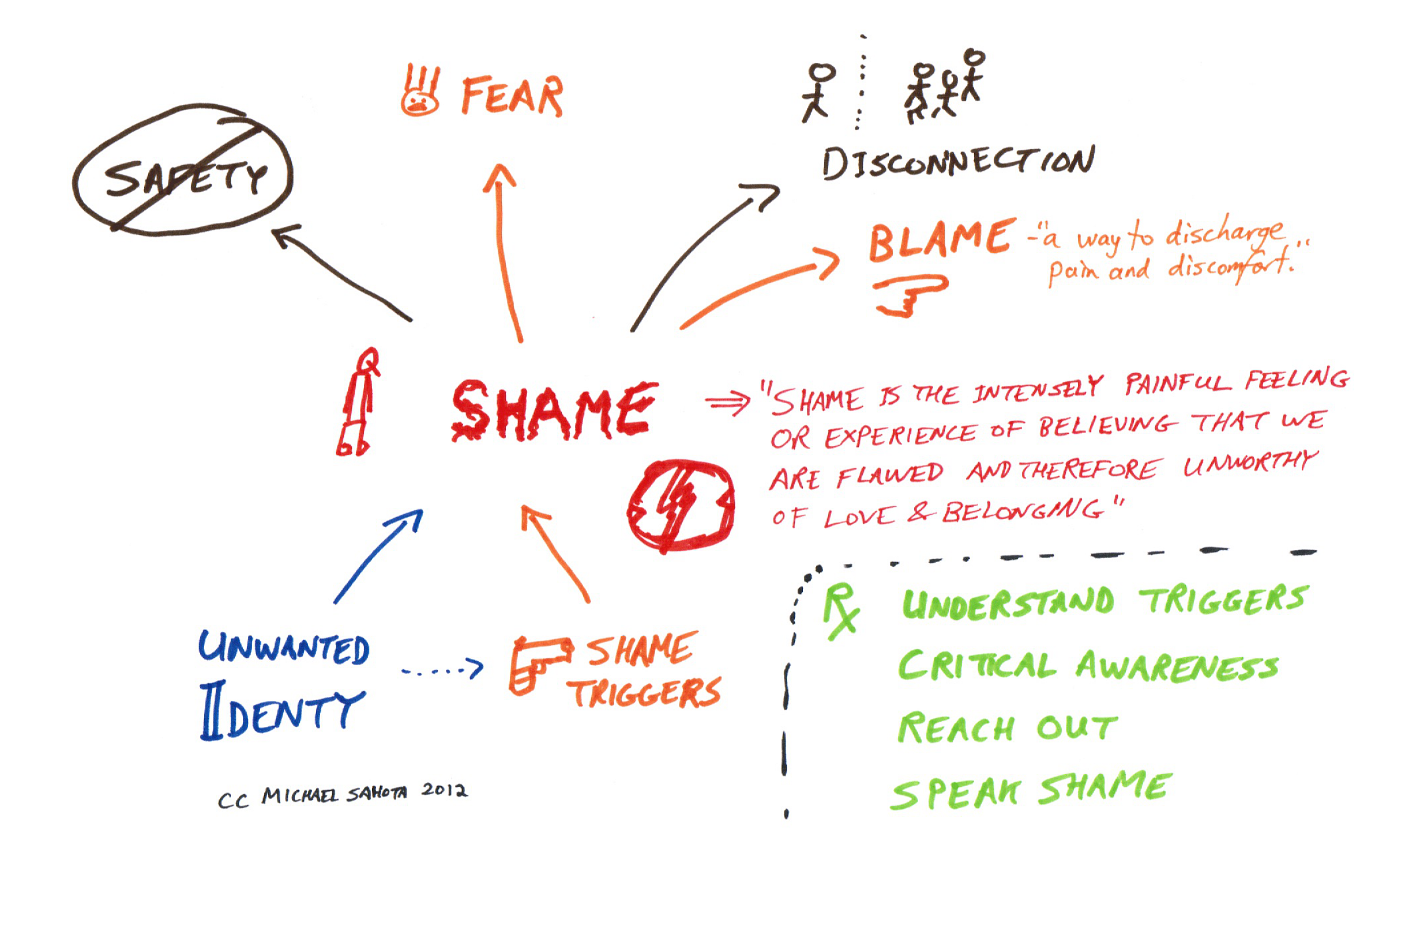
Shame is the Root of
self-destructive behaviors:
• Hidden shame often drives self-destructive behaviors and other psychological symptoms such as rage, avoidance, or addictions. • Self-destructive behaviors often are an attempt to regulate overpowering, and painful feelings that lead to more shame, propelling the self-destructive cycle. • Secrecy, silence, and out-of-control behaviors fuel shame. • Shame makes people want to hide and disappear, reinforcing shame. • Shame is created in children through scolding, judging, criticizing, neglect, abandonment, sexual and physical abuse.
Brown, 2017
Breaking the Cycle of Shame: Breaking self-destructive habits requires action, not just willpower • Changing destructive behaviors requires trying out new, affirming behaviors to replace them • New behaviors that generate positive feedback and reward create new connections in the brain, creating the momentum for ongoing growth and change. Shame can be healed by: • Breaking secrecy with people who understand • Becoming vulnerable in a safe environment that allows the client to take the healthy risk to be seen and known authentically, acting from a positive motive and trying out new behaviors in a safe and (nonjudgmental) setting.
Empowering actions that generates self-esteem are the antidote to shame.
https://psychcentral.com/lib/breaking-the-cycle-of-shame-and-self-destructive-behavior/
10 Points: Breaking the Cycle of Shame and Self-Destructive Behavior by Dr. Lynn Margolies

Slide 7
SHAME:
CORE BELIEFS
GIVES YOUR POWER AWAY
AND ALLOWS EXTERNALS, E.G. PEOPLE AND THINGS TO DEFINE AND CONTROL YOU. IT IS GUARANTEED TO KEEP YOU IMPRISONED
BECAUSE EVERYONE HAS UNCONSCIOUS BIASES, HIDDEN AGENDAS, EXPECTATIONS, PROJECTIONS AND DIFFERENT PERSPECTIVES THAT ARE ALWAYS CHANGING. AS LONG AS YOU DRAW YOUR SELF WORTH AND VALUE FROM OTHERS, OR FROM MATERIAL THINGS, AND WHAT YOU DO OR FAIL TO DO, YOU WILL NEVER BE FREE.
A LOT OF THIS ISSUE STARTS IN CHILDHOOD FROM A PROCESS OF INTERNALIZATION WHERE WE COPY AND INCORPORATE THE LIFESTYLE, BELIEFS/PROJECTIONS AND PROBLEM SOLVING SKILLS/WAYS OF COPING FROM SIGNIFICANT PEOPLE IN OUR LIFE, e.g. childhood attachment issues that follow us into adult relationships.
STOCK PHOTO FROM SHUTTERSTOCK
THE ROOTS OF SHAME
The “self-in-the-eyes-of-the-other” is the focal point of shame - “I am as I am seen” – that is we internalize the perception judgment(s) others have of us and accept it as true. Shame is self-judgment and condemnation of the self “I am a bad person”
Brown, 2017
Brown, 2017
Amos 3:3 – How can two people walk together unless they are in agreement.
Shame is a developmental issue that necessitates maturing from an external locus of control to an internal one & embracing our uniqueness through individuation & differentiation.
Notes:
When feeling ashamed we instinctively turn away or hide from other people. Shame is a self-absorbed, self, centered, and isolating experience. Shame is triggered by a “perceived” fundamental break in one’s connectedness to others or to oneself.

Slide 8
“Serpentining" means trying to control a situation, backing out of it, pretending it's not happening, or maybe even pretending that you don’t care. We use it to dodge conflict, discomfort, confrontation, the potential for shame or hurt, and/or criticism (self- or other-inflicted). Serpentining can lead to hiding, pretending, avoidance, procrastination, rationalizing, blaming, and lying. Shame also influences the ways we live within relationships. An Example might be an addiction to pornography and how it exacerbates guilt and shame, fear of being found out, hiding, separation and distance in relationships. When done covertly it hurts a spouse’s self-esteem and self-image when discovered.
In order to protect ourselves from shame, we all have masks and defense mechanisms. This “shielding” is our way to protect from vulnerably and exposing our true selves to the world?
Perfectionism: Our trying to do everything perfectly in an attempt to avoid shame and judgment.
Avoidance: It’s safer to live a a life of routine (without risking joy) and disappointment rather than to get caught off guard by hurt. If we live with a negative attitude and expect bad things, then we don’t have to feel the emotions that come from failure.
Numbing: We try to embrace whatever deadens the discomfort and pain of shame. For some that might include alcohol, drugs, and sex, or things like busyness, over-eating, over-working, and/or over-buying to also numb reality.
Brown, 2017
http://www.isaacarchuleta.com
Excerpted from - Daring Greatly: How the Courage to Be Vulnerable Transforms the Way We Live, Love, Parent, and Lead – by Brene Brown

Slide 9
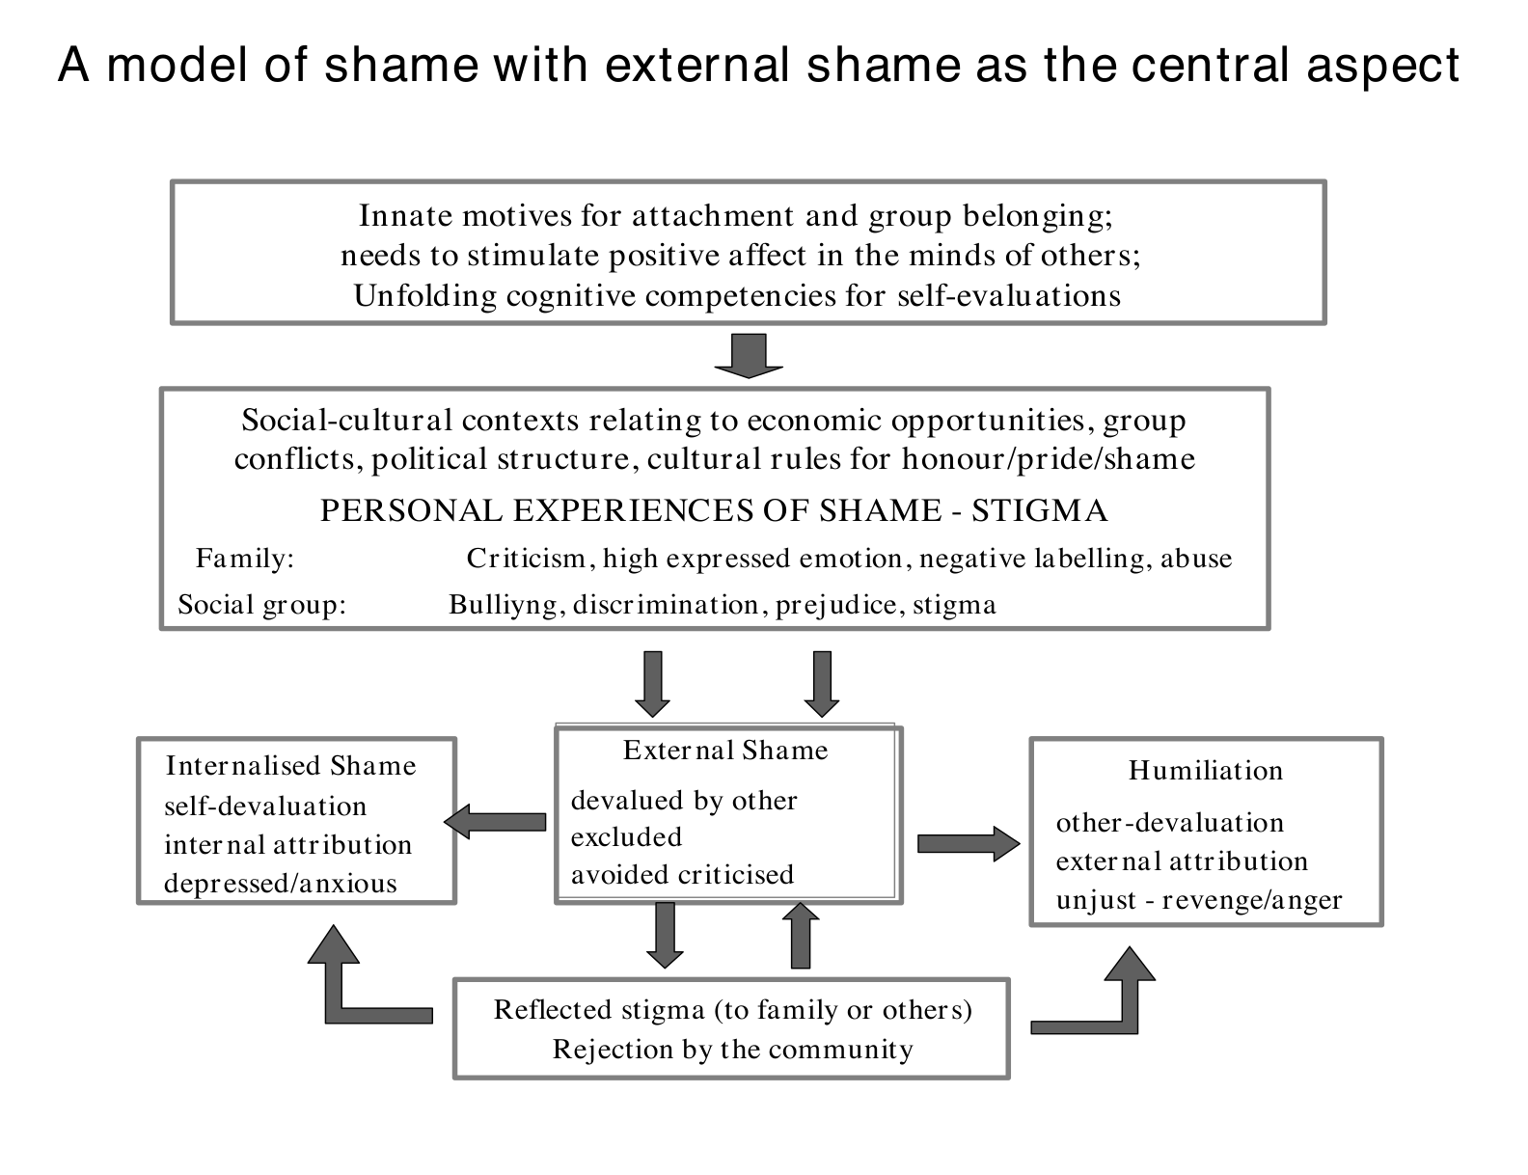
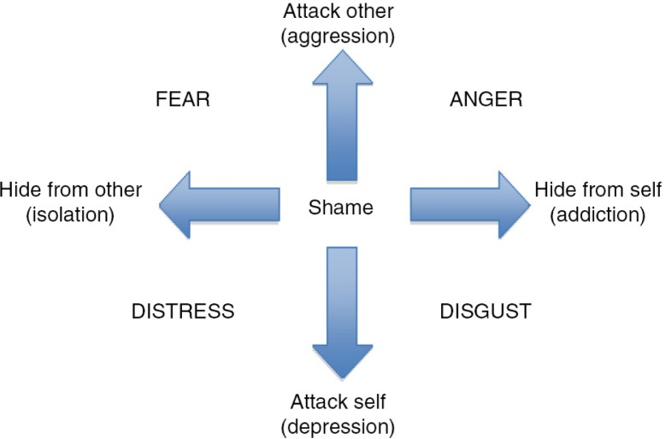
STOCK PHOTO FROM SHUTTERSTOCK
Compass of shame-avoidant behaviors
and masking emotions (Webb, 2010).
Paul Gilbert - An introduction to the theory & practice of compassion focused therapy and compassionate mind training for shame based difficulties. www.compassionatemind.co.uk
*A traumatized child blames their own self for the abuse or neglect from their parent and empathizes with them because they are their sole source of security and soothing. That is why as counselors we often see minimization and denial of a parent's influence by our adult clients. However, clearly stating how significant the situation was helps people feel some relief from their self-blame. "Your father was abusive." Your mother was an alcoholic." "It was horrible what you went through." As their therapist we can help them reframe their perspective and help them free themselves from the shame they carry.
*Many people (mostly men) feel that shame for only seconds before they shift to anger or rage, or behaviors that make them feel more in control. Helping these clients to feel/process their shame and sadness is what will allow/lead them to heal and find peace.
Terry Real - Relational Life Therapy - https://www.terryreal.com
Notes:
https://www.ncbi.nlm.nih.gov/pmc/articles/PMC4580708/. = PTSD & SHAME
https://www.ncbi.nlm.nih.gov/pmc/articles/PMC5126791/. = SHAME & PTSD

Slide 10
HEALTHY DEVELOPMENT AND MATURITY: Spiritually, Mentally, Emotionally, Behaviorally, & Relationally - “When I was a child, I spoke as a child, I understood as a child, I thought as a child: but when I became an adult, I put away childish things.” (1st Corinthians 13:11, NIV)
Amos 3:3/Micah 6:8 - The earliest mention of shame & fear that I found was in Genesis 3 story of the Bible, of the fall of Adam & Eve.
Facing your Demons: As a person develops and matures spiritually through faith, they act on their faith to confront and challenge their fears and assumptions learned through multigenerational processes and their family of origin. This personal experiential movement discovers new truths (John 8:31-32) which is incorporated and internalized. Old beliefs (Romans 12:2(a) & fears (2nd Timothy 1:7) are overcome and replaced through individuation and differentiation. They begin to develop their own personal identity maybe even other than the familial role that they had accepted when they were younger and immature. As this process continues & they overcome older familiar ways, their emotions are transformed to align and become congruent to the new (2nd Corinthians 5:16-17).
They become more empowered, and their internal locus of control grows stronger.
Their behaviors changes more and more to come into agreement (Amos 3:3) with who they are becoming and their significant relationships that they are in. They are
healing from their past and becoming more healthy and whole. The knowledge that they have learned turns into wisdom as they learn new ways of coping, and applying what they have learned. They respond more instead of reacting, and able to process loss and grief better with the realization that everything changes and they have no control over anything except themselves. They learn to live with uncertainty, and give grace to others to be themselves and different without the need to control or try and change them.
STOCK PHOTO FROM SHUTTERSTOCK
Everyone experiences shame in slightly different physical and emotional ways, but some key elements underlie the phenomenon. There are almost always physical manifestations — These symptoms are akin to the sensation of panic, which, like shame, triggers a fight-or-flight response in the body. The emotional experience of shame is fueled by negative self-talk. Shame cause us to distance ourselves from others and become very negative about ourselves and our world gets much smaller. Shame only exists through secrecy - Shame can only survive and incubate if we don’t speak about it — that’s where it derives its power.
Brené Brown, PhD, LMSW, The Gifts of Imperfection: Let Go of Who You Think You’re Supposed to Be and Embrace Who You Are (Hazelden, 2010)
Notes:
Micah 6:8 - He has shown you, O mortal, what is good. And what does the LORD require of you? To act justly and to love mercy and to walk humbly with your God.

Slide 11
"Your eye is a lamp that provides light for your body. When your eye is good, your whole body is filled with light. But when it is bad, your body is filled with darkness. Make sure that the light you think you have is not actually darkness. But if your whole body is enlightened, and there is no darkened part, it shall be shining entirely like a lamp giving you light by its flame” Luke 11:34-36
The Talmud says “We don’t see things as they are; we see them as we are.” Some people put others down as a way to lift themselves up in an attempt to be Superior by making another feel inferior – They are trying to be a somebody by making someone else a nobody. / Proverbs 18:21(a) - The tongue has the power of life and death... / Blaming others for our failures – scapegoating / Projection (is a defense mechanism): Sigmund Freud first coined the term projection, describing it as a way in which an individual projects their undesirable thoughts, traits, and beliefs onto someone else. Their delicate ego has to be protected at all costs and so the blame for their failure has to be directed elsewhere.
SERENITY PRAYER: God grant me the serenity to accept the things I cannot change; courage to change the things I can; and wisdom to know the difference. Living one day at a time; and enjoying one moment at a time - Reinhold Neibuhr (1892-1971)
Notes:
Full Circle = we relate to others as we learned to relate – need to mature to a point of individuation and differentiation (adult seeing others adults as individuals with their own issues just as we have – as do our parents)
Ned to live from a paradigm where we love (God wholeheartedly), and others as ourselves = mutuality.

